Slide 1
Wildland Fire: 2023 Season Update and Federal Investments
June 5, 2023

Slide 2
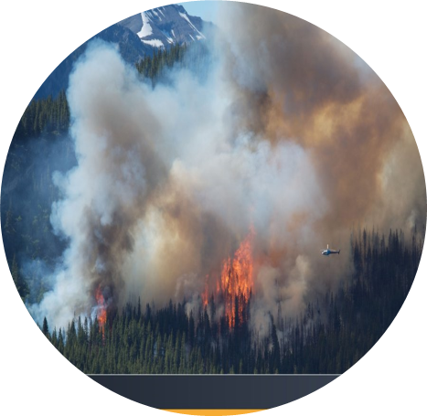
Background and Context
Wildland fires are Canada’s second most costly disaster.
Climate change is increasing the frequency and intensity of wildland fires.
The size of Canada’s wildland-urban interface (WUI) is growing.
Indigenous communities in Canada are at a higher risk.

Slide 3
National Roles and Responsibilities
Provinces & Territories
Fire suppression
Forest management
Risk mitigation
Emergency response
Government of Canada
National emergency management, coordination
Wildland fire science, technology &expertise
Public safety & education
International agreements
Federal lands
Canadian Interagency Forest Fire Centre
Coordinates national/international resource support
Strategic planning and information sharing
Home of FireSmart Canada
Indigenous, municipal, and regional governments play a critical role in fire and emergency management at local scales.

Slide 4
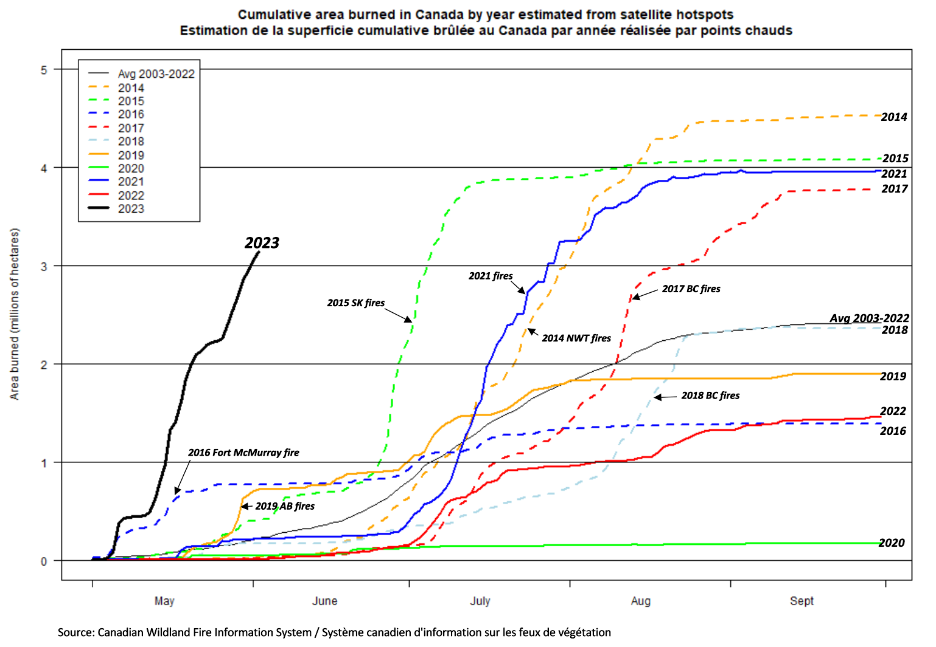
Area burned
Canada is experiencing an unprecedented amount of fire activity for this early in the wildfire season.
The rate of increase of area burned to date is high.
If this rate continues, we could exceed the largest total ever recorded in Canada.

Slide 5
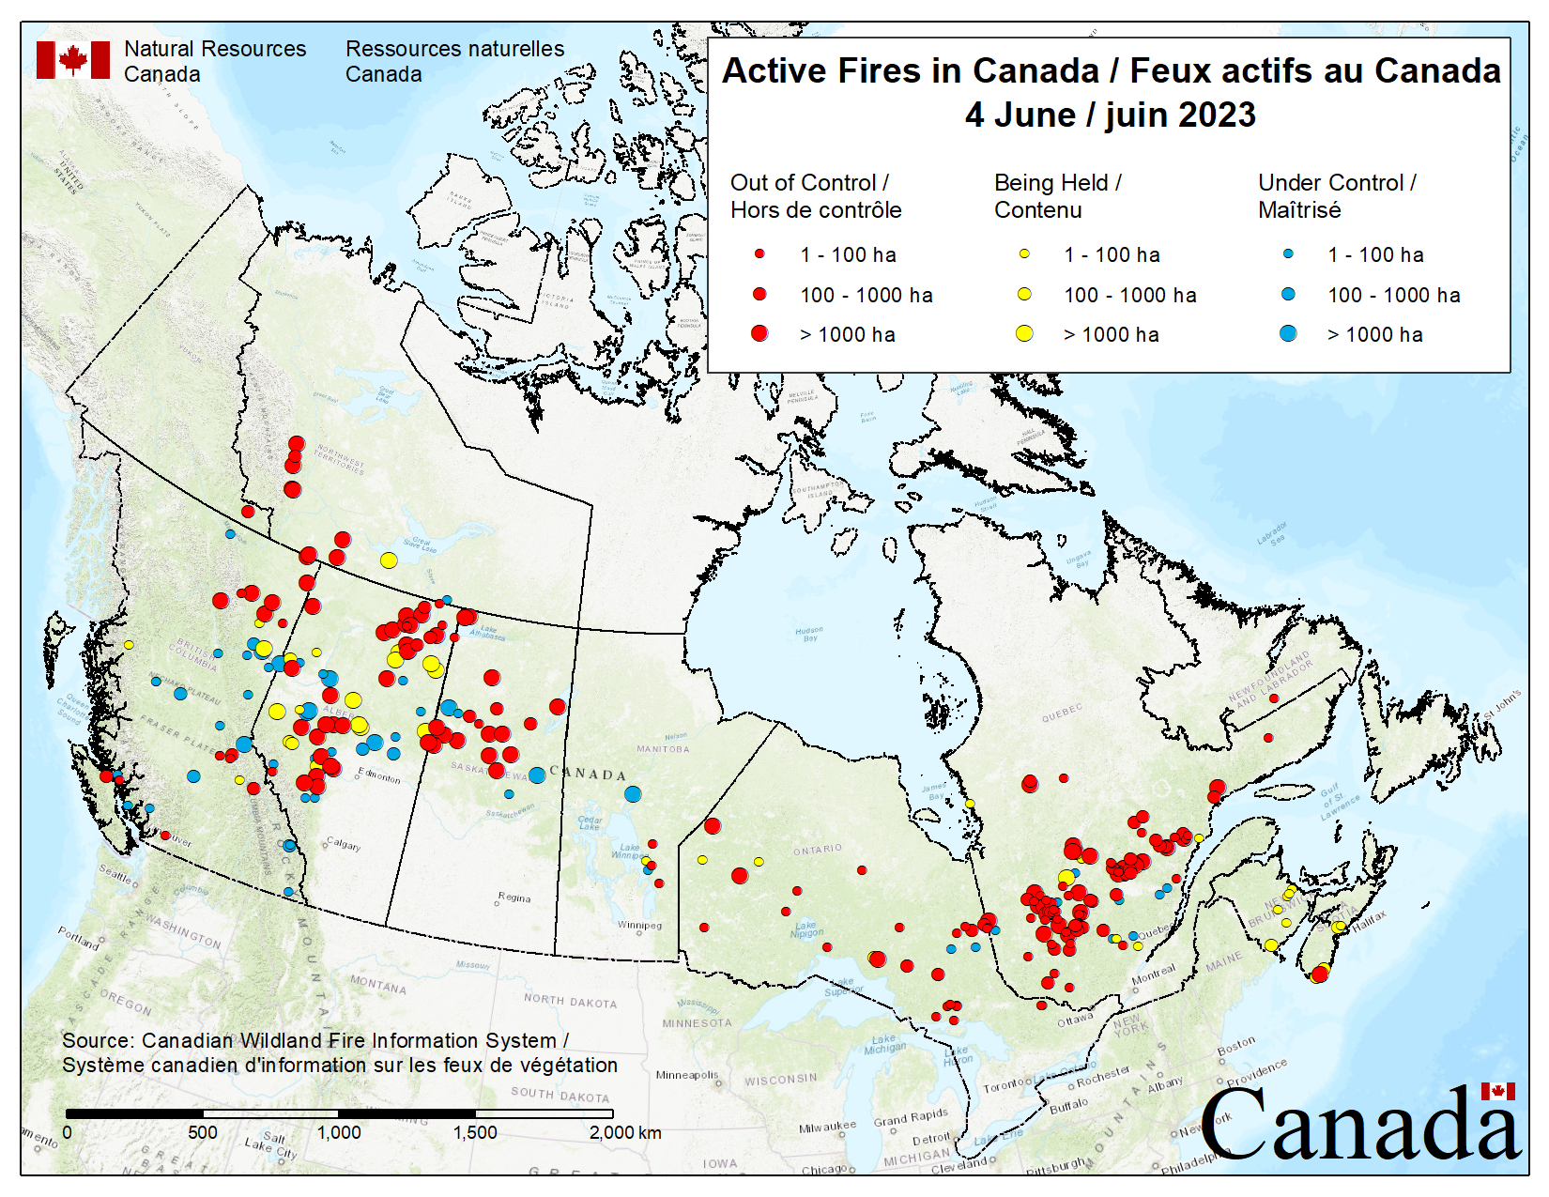
Active Fires
Currently 413 active fires (as of June 4, 23:30 ET)
For this time of year, fire occurrence from coast to coast is not normal.
Most fires tend to occur in the north away from large population centres, placing remote and rural communities at higher risk.
Interface fires are the most detrimental and can cause tremendous economic and structural damage.
The Canadian Wildland Fire Information System (CWFIS) provides 24-7 access to wildland fire information and data.

Slide 6
Year-to-Date (as of June 4, 2023)
2,214 fires nationally with approximately 3.3 million hectares (ha) burned
The ten-year average over same timeframe is 1,624 fires and 254,429 ha burned
Evacuations: approximately 26,206 people currently under evacuation
+120,000 evacuated to date
Evacuations currently in BC, AB, NT, SK, QC, NS
National Fire Preparedness Level: 5
Full commitment of national firefighting resources, with ongoing extreme demand and international assistance required.
Firefighting resources – interagency deployments:
Canadians deployed through CIFFC: 198
International firefighters currently in Canada: 957

Slide 7
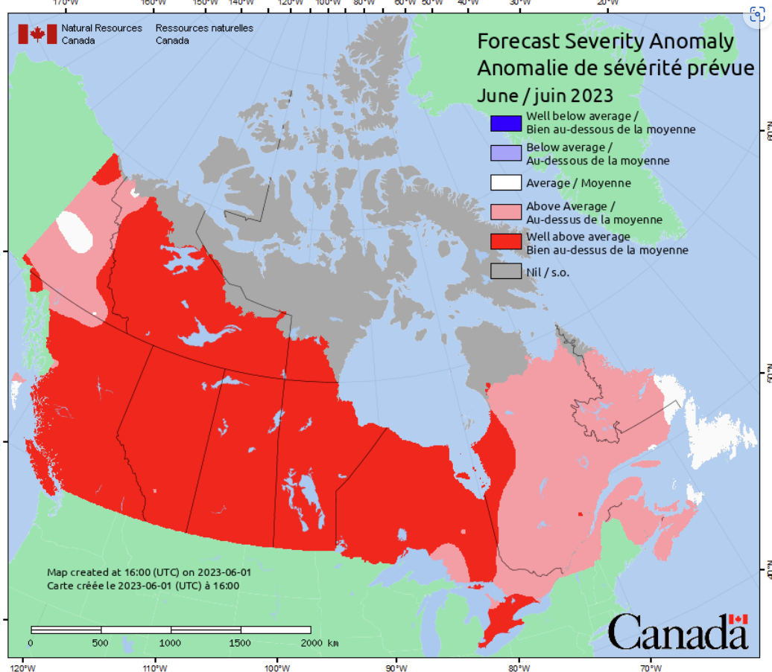
Forecast: June 2023
Projections indicate potential for higher-than-normal fire activity across most of the country through to August.
For June, warm and dry conditions will increase wildfire risk across most of the country (BC to western Quebec).

Slide 8
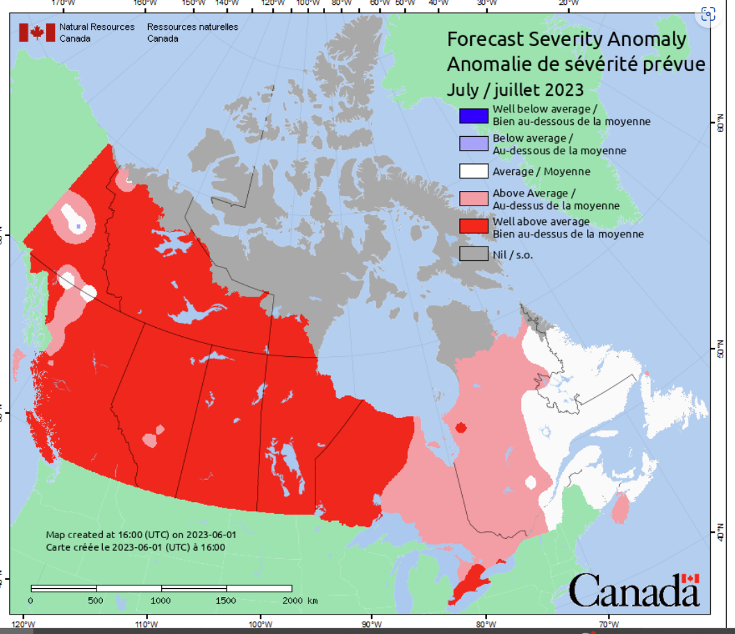
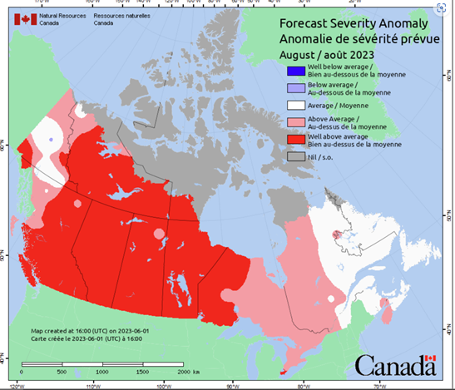
Forecast: July & August 2023
Projections indicate potential for higher-than-normal fire activity across most of the country through to August.

Slide 9
Existing Federal Investments in Wildland Fire
Enhanced wildfire research, modernized national wildfire information and decision-support systems
Improved emergency management and increased understanding of wildfire risk
Community-based wildfire firefighter training and equipment acquisition
Enhanced resilience and emergency management of First Nations communities
Structural and natural infrastructure to mitigate disasters
Increased wildfire management capacity in Canada’s national parks
The Government of Canada also works closely with provinces, territories and whole-of-society partners on wildland fire prevention and mitigation. This includes renewal of the Canadian Wildland Fire Strategy (2016), the Blueprint for Wildland Fire Science in Canada (2019-2029), and most recently, the Canadian Council of Forest Ministers’ national Dialogue on Wildland Fire and Forest Resilience.

Slide 10
New Federal Investments in Wildland Fire
WildFireSat
Up to $169.9 million over 11 years
Wildfire Resilient Futures Initiative
Up to $284 million over 5 years
Dedicated wildfire monitoring satellite system (first ever)
Expand wildfire prevention and mitigation measures (i.e., FireSmart Canada); fill foundational gaps in wildland fire knowledge; and​ establish a Centre of Excellence for Wildland Fire Innovation and Resilience
Disaster Mitigation and Adaptation Fund
Up to an additional $489.1 million over 10 years to improve resilience of communities

Slide 11
How to build resilience
Whole-of-Society Engagement
All levels of Government
Forest Management
Indigenous Knowledge
Business Sectors & Industry
Non-profit Sector
Individuals & Communities
Wildland fire response alone is no longer enough
Greater emphasis on prevention and mitigation by the “whole of society” is needed.
Understand, engage, and act

Slide 12
ANNEX

Slide 13
Selected Federal Investments Related to Wildfire Resilience
Budget 2022 provided: $269 million over five years, starting in 2022-23, to Natural Resources Canada to help provinces and territories procure firefighting equipment such as vehicles and aircrafts; $39.2 million over five years, starting in 2022-23, to Indigenous Services Canada to support the purchase of firefighting equipment by First Nations communities; $37.9 million over five years, starting in 2022-23, to Natural Resources Canada to train 1,000 additional firefighters and incorporate Indigenous traditional knowledge in fire management; $169.9 million over 11 years, starting in 2022-23, to the Canadian Space Agency, Natural Resources Canada, and Environment and Climate Change Canada to deliver and operate a new wildfire monitoring satellite system.
Budget 2021 provided: $28.7 million over five years, starting in 2021-22, to Natural Resources Canada to support increased mapping of areas in Northern Canada at risk of wildfires and enhance the capacity of the Canadian Interagency Forest Fire Centre’ $100.6 million over five years, starting in 2021-22, to the Parks Canada Agency to enhance wildfire preparedness in Canada’s National Parks; $1.375 billion over 12 years to renew the Disaster Mitigation and Adaptation Fund.
Budget 2019 provided: $151.23 million over five years, starting in 2019–20, ($9.28 million per year ongoing) to improve emergency management in Canada, including in Indigenous communities; $211.0 million over five years, starting in 2019–20 ($49.4 million per year ongoing) to support increased resiliency and emergency management on-reserve; $48.0 million over four years, starting in 2020–21, to renew funding for on-reserve infrastructure projects to protect communities from climate-related hazards.
Budget 2018 provided: initial investment of $2 billion over 10 years for the Disaster Mitigation and Adaptation (DMAF) fund.
Budgets 2017 and 2016 provided: The Investing in Canada plan included $180 billion over 12 years for the Investing in Canada plan to modernize infrastructure across Canada (including rural and northern communities), to be delivered by 21 departments and agencies; $42.5 million in financial support from Infrastructure Canada (2016-2021) to the National Research Council of Canada for work to integrate climate resilience into building infrastructure, guides, codes.

Slide 14
Federal Government Roles – Wildland Fire
Public Safety Canada: The Government Operations Centre (GOC) leads federal response coordination for emergencies, which includes maintaining federal situational awareness, developing integrated risk assessments, and supporting response coordination.
Canadian Armed Forces (CAF): May provide limited self-sustaining support to front-line relief operations, excluding social crises and enforcement/security tasks, once all available options have been exhausted, including PT and private sector.
Natural Resources Canada (NRCan): Leads international memorandums of understanding/ arrangements for fire management cooperation and resource exchange; conducts monthly national fire season forecasting; provides wildfire intelligence and predictive services; and, monitors and reports on national fire locations and conditions.
Environment and Climate Change Canada (ECCC): Provides specialized weather and wildland fire-related products and forecasts including air quality and smoke transport modeling, which could be used for evacuation planning and assessing potential health impacts.
Indigenous Services Canada (ISC): Provides funding for preparedness, mitigation, response and recovery activities for on-reserve communities; helps facilitate the coordination of operations between FPT partners and supports impacted First Nations (FN); assists host communities with the delivery of services for FN evacuees; provides and makes arrangements for health programs and social services.
Parks Canada Agency (PCA): Manages wildland fires across 350,195 km2 of federal Crown lands.
Service Canada/ESDC: Facilitates access to services and benefits and flows resources quickly to those whose employment has been interrupted and require temporary income support, identity document replacements and to employers whose businesses have been also impacted.
Public Health Agency Canada (PHAC): coordinates access to Health Portfolio health related supports; maintains the National Emergency Strategic Stockpile (NESS) which maintains emergency social services assets such as beds and blankets to support temporary accommodations for evacuations; work with ECCC to provide the Air Quality Health Index, health-risk messaging on wildfires and air quality.
Innovation, Science and Economic Development Canada (ISED): Information gathering and sharing systems, networks and protocols to detect telecommunication disruptions or events of significance that facilitate effective communication and collaboration across the telecommunication sector/industry
Transport Canada (TC): Situation Centre provides 24/7 monitoring of the transportation system and a single window for incident reporting by industry; facilitate transportation movement by issuing exemptions and adjusting regulatory requirements for air and rail when/where necessary.

